Slide 1
Spring 3.0
Spring developed Rod johnson,
1.0 released in 2004
updated entire codebase for Java 5 code style (generics, varargs, StringBuilder), Spring.jar removed, and made many small jar files.

Slide 2
Spring provides nothing, other than own implementations of
DI, AOP implementations. itself using DI & AOP to provide EASY integration
with DB and its frameworks, Web-service, EJB, JMS, web and its frameworks, Scheduling and others.
Integrations made easy by Template pattern and call back mechanism
We have many components / API ( servlet, EJB, Endpoints,JMS, JavaMail), many DB frameworks ( JPA, iBatis, Hibernate),
Many WEB frameworks ( Struts, JSF ) to co-ordinate with them we need a guy. Whose name is SPRING Framework.

Slide 3
If a new project, I can get all the facility provided by EJB container as service like , serialization, transaction, security and some of them, IN SPRING ITSELF, as light weight. ..
But there are some components are there, those are already developed, want to re use, spring provide excellent facility to integrate them
In project.
..
That why those NEW project has spring,
It wont have EJB also. ( at least mostly )

Slide 4
Spring Context / BeanFactory instantiated by
JSE application for standalone application
Web application : DispatcherServlet for Web application and Remoting services
Web application : MessageDispatcherServlet for webservice ( Spring-WS )
EJB application : BeanFactoryLocator
Spring TestContext

Slide 5
Spring is really SEA, for those know spring well.
( it has
DI,
AOP,
working with DB and its framework in java,
Working with web and its frameworks in java,
Working with JMS,
Working with Remoting,
Working with Enterprise Application Integration ( EAI )
Most of task made easy by many PostProcessor including discovery of bean, autowire, proxy for aspect, ORM Exception handler, timer task

Slide 6
Advantage of Spring
It implements most of Design pattern for us
Externalizing the configuration
Easy for Unit Testing, loose coupling and simplicity
Reduce the code in a application using DI, AOP, avoiding boilerplate code like EJB
Prefer Annotation based configuration
As long as we are not extending spring
Capability or adding any features

Slide 7
SpringSoruce is primary for spring framework
SpringSource has many extension including Roo, BlazeDS
SpringSoruce Tool Suite ( STS ) is IDE plugin for Eclipse for Spring application development
SpringSoruce has own tc server for easy development of
Spring application

Slide 8
Spring
Integration
Spring with JMS
Spring access EJB
Spring with Persistence
Spring with Remote ( expose & Access )
Spring with JNDI
Spring with Scripting language support
Transaction management
Spring with JavaMail
Exception handling
Timer ( java 1.3 )
Spring Job Scheduling
Quartz

Slide 9
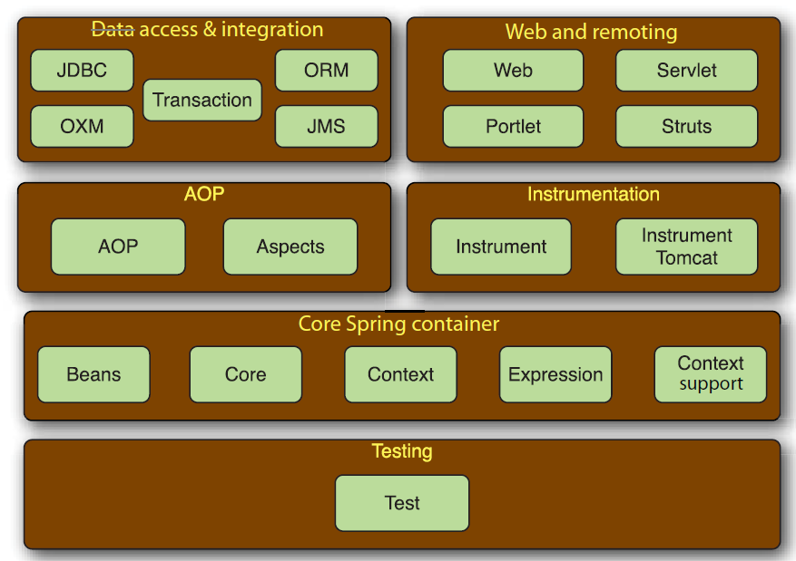

Slide 10
Without Spring, the Web Component directly depends on either JNDI or ServiceLocator to use Business Component(EJB). With help of Spring, that Business Component injected to web component and it is referred by interface. That component can be either EJB / WebService / SimpleBean
The Spring Framework reduce the amount of coding in project. But not giving any technology like ejb / webservice

Slide 11
Spring Bean Configuration
XML based
Java based ( from Spring 3.0 )
Spring
Annotation
For discovery
Every thing in XML
( old approach )

Slide 12
Wiring approach
Explicit Wiring in XML file
( <property>, <constructor-arg>
Autowire
( avoid <proeprty> and <constructor-arg> )
Spring's
XML attribute
For wiring
Annotation
Spring's
Annotation
For wiring
Inject
( JSR - 330 )
( I prefer )
Resources
( JSR -250 )

Slide 13
Integration with others
IOC
AOP
Spring
Spring is act as container, because it create object for our bean and wire its dependency

Slide 14
Spring DI – wiring bean with other bean

Slide 15
Dependency Objects obtained by 3 different ways
Using new Operator
Use of Factory methods
It is done by Spring framework
Injected at runtime by some External Process.
Spring, helps to avoid own implementation of Factory pattern, Service Locater patterns.

Slide 16
Inversion – application does not control its structure
IOC Framework – take control of structure of application
Any Resource is managed by Spring called as BEAN
IOC Container
Dependency Iookup
Dependency Injection
Constructor Injection
Setter Injection

Slide 17
IoContainer obtained AS
BeanFacory
ApplicationContext

Slide 18
BeanFactory capability
<alias> for bean name
Constructor / Setter DI
( simple Type / Collection / BeanReference)
Bean configuration inheritance
(abstract, parent )
P - namespace alternative to <property> tag. It keep xml file as much as minimum tag
Bean Factory nesting
(we can configure spring bean in separate file and use its bean factory as parent. This will keep out application bean xml file clean)
Life cycle notification for Only singleton bean
( java Interfaces / init-method, destroy-method / @PostConstruct, @PreDestroy )
BeanNameAware, BeanFactoryAware
Method Replacement (MethodReplacer,
<replaced-method>)
Scope of Bean (singleton/Prototype/request/session/global session)
FactoryBean
( FactoryBean return another Bean instance instead itself )
Lookup Method injection
<lookup-method> to get another bean
Autowire
(by type /name/ constructor/ auto)
BeanFactoryPostProcessors
BeanPostProcessor
Dependency on
(depends-on)
& Dependency check
(simple / object /all)
Property Editor
Factory-method
(create instance by static method instead of public constructor)
Support for XML & property file configuration

Slide 19
Application Context capability
automatic configuration of infrastructure beans
. That is any of declared beans implement these interfaces its added to application context automatically.
( BeanPostProcessor /
BeanFactoryPostProcessor/
ApplcationEventListener/
CustomPropertyEditors )
Internationalization
Additional life cycle interfaces
Annotation based configuration
Application Event
Easy for accessing different resources that use different protocols in unified way
Allow, all the resources / configure the factory in declaratively
Load bean on startup
(lazy-init = false)

Slide 20
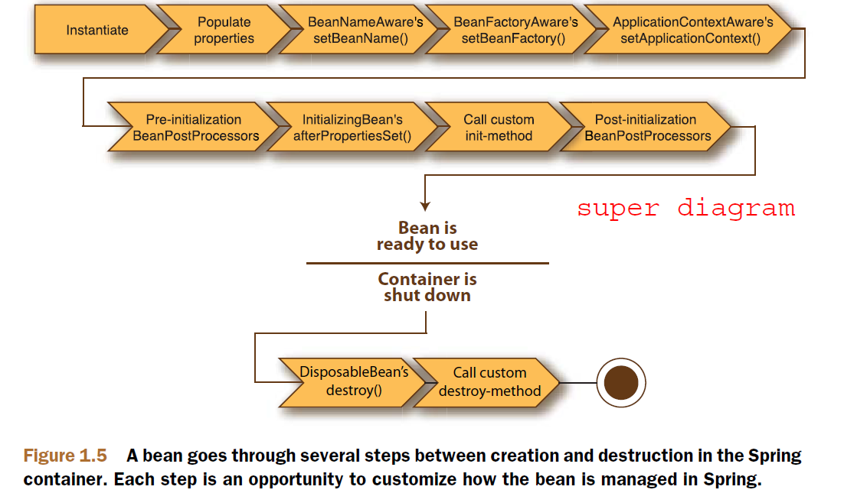

Slide 21
Lifecycle approach
Implementing Spring API
XML configuration
Java Common Annotation
( I prefer )

Slide 22
Collection configuration
( I must use XML file till 3.0 )
List
Set
Map
Loading property file
Properties

Slide 23
Spring Expression Language (SpEL ) from 3.0
It is executed at runtime. It support both constructor and setter DI
Accessing Bean attribute and instance method (API or our method )
Accessing Static attribute and static method by T()
Collections element access by index or key
Collections Projection and create subset of collection
Support Arithmetic operation and logical operations
Ternary operator and Elvis operator
Null validation and uppercase
Regular Expression support

